Slide 1
Applied Statistics, Probability theory and mathematical statistics
István Fazekas, Attila Barta, Sándor Pecsora
Independence of events
”This work was supported by the construction EFOP-3.4.3-16-2016-00021. The project was supported by the European Union, co-financed by the European Social Fund.”

Slide 2
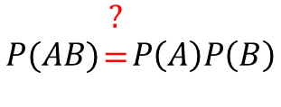





Exercise 6.1 (M1)
A coin is tossed ten times. Let A denote the event that there are both heads and tails among the results, while B denotes the event that there is at most one tail among them. Are A and B independent?
$$A−there is at least a head and at least a tail \\ B−there is at most one tail$$
$$P(AB)\begin{matrix}? \\ = \\ \end{matrix}P\left(A\right)P\left(B\right)$$
$$P\left(AB\right)=\frac{10}{2^{10}}$$
$$P\left(A\right)=1−\frac{2}{2^{10}}=\frac{2^{9}−1}{2^{9}}$$
$$\frac{10}{2^{10}}≠\frac{11}{2^{10}}×\frac{2^{9}−1}{2^{9}}$$
$$P\left(B\right)=\frac{1+10}{2^{10}}=\frac{11}{2^{10}}$$

Slide 3
Exercise 6.1 (M1) MATLAB solution
N = 10^7;
A = 0;
B = 0;
AB = 0;
for i=1:N
sim = randi(2,1,10)-1;
s = sum(sim);
if s>0 & s<10
A = A+1;
end
if s<=1
B = B+1;
end
if s==1
AB = AB+1;
end
End
(A/N) * (B/N)
AB/N

Slide 4


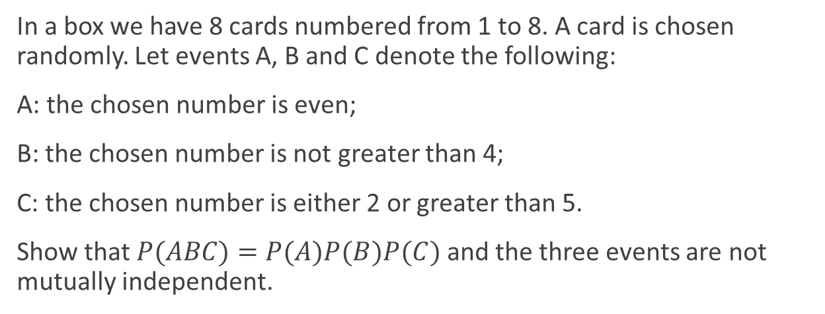



Exercise 6.3
In a box we have 8 cards numbered from 1 to 8. A card is chosen randomly. Let events A, B and C denote the following:
A: the chosen number is even;
B: the chosen number is not greater than 4;
C: the chosen number is either 2 or greater than 5.
Show that$P(ABC)=P(A)P(B)P(C)$ and the three events are not mutually independent.
$$P\left(A\right)=\frac{1}{2}$$
$$P\left(ABC\right)=\frac{1}{8}$$
$$P\left(B\right)=\frac{1}{2}$$
$$P\left(AC\right)≠P\left(A\right)P\left(C\right)$$
$$P\left(C\right)=\frac{1}{2}$$

Slide 5
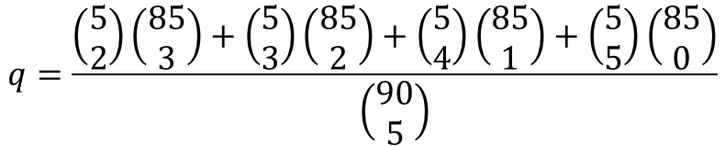
Exercise 6.5 (M2)
Two lottery coupons (5 from 90) are filled independently of each other. What is the probability of winning, i.e., of hitting at least two winning numbers?
$$q−The probability, that one coupon wins$$
$$q=\frac{\left(\begin{matrix}5 \\ 2\end{matrix}\right)\left(\begin{matrix}85 \\ 3\end{matrix}\right)+\left(\begin{matrix}5 \\ 3\end{matrix}\right)\left(\begin{matrix}85 \\ 2\end{matrix}\right)+\left(\begin{matrix}5 \\ 4\end{matrix}\right)\left(\begin{matrix}85 \\ 1\end{matrix}\right)+\left(\begin{matrix}5 \\ 5\end{matrix}\right)\left(\begin{matrix}85 \\ 0\end{matrix}\right)}{\left(\begin{matrix}90 \\ 5\end{matrix}\right)}$$
$$1−q −The probability, that one coupon loses$$
$${\left(1−q\right)}^{2} −The probability, that both coupons lose$$
$${1−\left(1−q\right)}^{2} −The probability, that at least one coupon wins$$

Slide 6
Exercise 6.5 (M2) MATLAB solution
winner = sort(datasample(1:90,5,'Replace',false));
n = 1000;
c = 0;
w = [];
for i=1:n
x = datasample(1:90,5,'Replace',false);
y = datasample(1:90,5,'Replace',false);
if length(intersect(winner,x))>1 | length(intersect(winner,y))>1
c = c+1;
w = [w; sort(x); sort(y)];
end
end
c/n
1-((nchoosek(85,5)+5*nchoosek(85,4))/nchoosek(90,5))^2
winner
i = 1;
w([i*2-1,i*2],:)

Slide 7


Exercise 6.7 (M3)
Two soldiers shoot on a target in turn until the first hit. The probability that the starter hits it is 0.2, while the second hits it with probability 0.3. What is the probability that the first successful shot belongs to the soldier who started the shooting?
$$p−the probability, that the first soldier hits the target first$$
$$P_{1}\left(H_{i}\right)−the probability, that the first soldier hits the target in round i$$
$$P_{2}\left(H_{i}\right)−the probability, that the second soldier hits the target in round i$$
$$P_{1}\left(H_{1}\right)=\frac{2}{10}$$
$$P_{1}\left(H_{2}\right)=\frac{8}{10}×\frac{7}{10}×\frac{2}{10}$$
$${p=P}_{1}\left(H_{1}\right)+P_{1}\left(H_{2}\right)+…=\sum_{k=0}^{∞}{0.2×{0.8}^{k}×{0.7}^{k}}=0.2×\sum_{k=0}^{∞}{{0.8}^{k}×{0.7}^{k}}=0.2×\frac{1}{1−0.56}$$

Slide 8
Exercise 6.7 (M3) MATLAB solution
f = 0;
s = 0;
n = 1000;
for i=1:n
while true
if rand()<.2
f = f+1;
break;
elseif rand()<.3
s = s+1;
break;
end
end
end
f/n
0.2 / 0.44

Slide 9
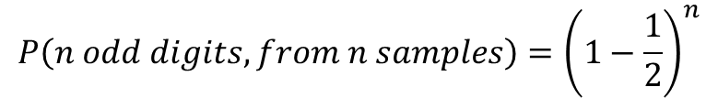



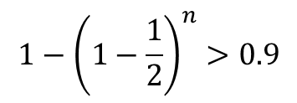
Exercise 6.9
The ten digits are written on ten separate cards. A card is chosen randomly, the digit on it is noted and the card is replaced. How many cards should be chosen to have an even number among them with probability greater than 0.9?
$$P\left(A\right)−the probability that at least one digit is even \\ P\left(A\right)>0.9$$
$$P\left(n odd digits, from n samples\right)={\left(1−\frac{1}{2}\right)}^{n}$$
$${1−\left(1−\frac{1}{2}\right)}^{n}>0.9$$
$$0.1>\frac{1}{2^{n}}$$
$$2^{n}>10 \\ n>3$$

Slide 10
Literature
Ágnes Baran: Mathematics for engineers 1. (Laboratory slides)
Sándor Baran: Probability theory and statistics
Fazekas István: Valószínűségszámítás, Debreceni Egyetemi Kiadó, 2009
Fazekas István: Bevezetés a matematikai statisztikába, Debreceni Egyetemi Kiadó, 2009
Matlab examples: https://www.mathworks.com/help/examples.html

